Slide 1
Monopolistic Competition Market
1511HS211 Economics

Slide 2
Monopolistic Competition Market
1511HS211 Economics
Many firms selling products that are similar but not identical.
Monopolistic competition has characteristics that are in common with both perfect competition and monopoly.
Examples: Shoes

Slide 3
Monopolistic Competition ( Market Characteristics)
1511HS211 Economics
Market Structure Characteristics
Number & Size distribution of sellers | Many small sellers. Actions of individual sellers go unheeded by other firms.
Number & Size distribution of buyers | Many small buyers.
Product differentiation | Slightly differentiated. Product of one firm is a fairly close substitute for that of other sellers.
Conditions of Entry and Exit | Easy entry and exit.

Slide 4
Certain Implications
1511HS211 Economics
There are many sellers in monopolistic competition, but each of them is able to identify its own small market segment.
An individual firm’s actions doesn’t directly affect the action of other firms. In this structure, no firm pays attention to the action of other firms but is sensitive to average market price.
Collusion is difficult as there are many sellers.
As there are many sellers market is competitive.
As products are slightly differentiated it is monopolistic.
The product differentiation may be the result of materials, workmanship, design, service, advertising.
Most common in retail and service sector
Firms in monopolistic competition have some control over price because their products are differentiated.

Slide 5
Monopolistically competitive firm Demand Curve
1511HS211 Economics
Price
D
Quantity of Output
Less elastic than Perfectly competitive firm but More elastic than Monopoly Firm

Slide 6
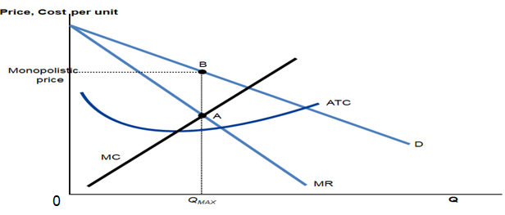
Profit- Maximizing Price and Output Determination-Short run
1511HS211 Economics
Profit maximization happens at a point where MC = MR.
Having determined output, the firm will charge what consumers are willing to pay (determined by the demand curve).
At point A, intersection of MR and MC determines profit maximizing output
And then at point B, the demand curve shows the price consistent with this quantity

Slide 7
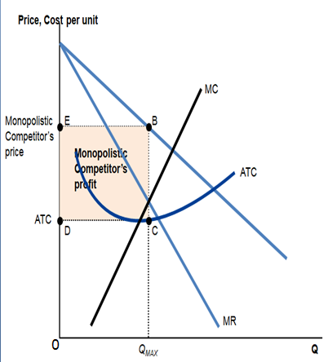
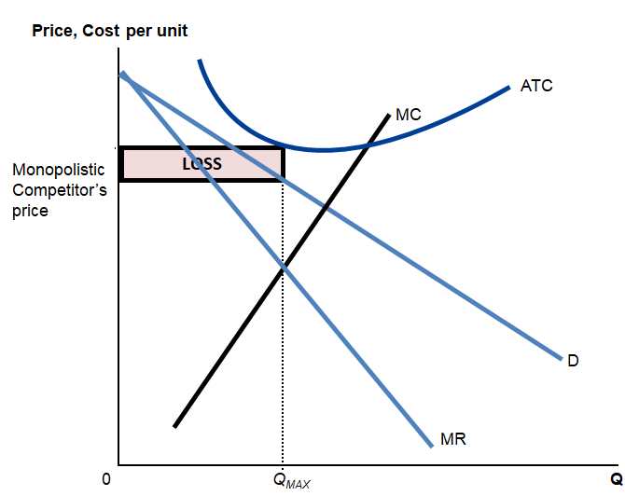
1511HS211 Economics
Profit Short Run
Loss Short Run

Slide 8
1511HS211 Economics
Profit- Maximizing Price and Output Determination-Long run
In the long run, like perfect competition entry into the industry is easy and so economic profit induces other firms to enter.
Firms entry continues into the industry as long as firms earn an economic profit—as long as (P > ATC).
A monopolistic competitor faces a downward sloping demand curve, and produces where MC = MR, not where MC = P.
The ATC curve is tangent to the demand curve at that level, which is not at the minimum point of the ATC curve.

Slide 9
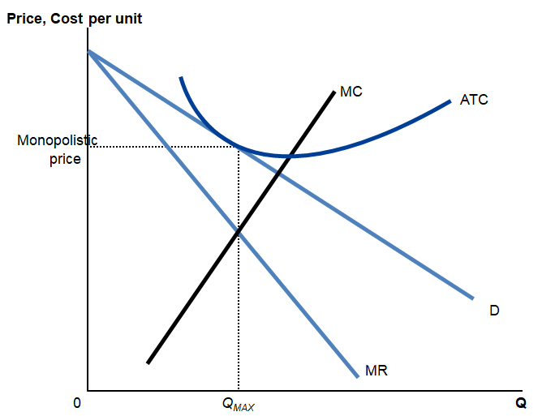
Profit- Maximizing Price and Output Determination-Long run
1511HS211 Economics

Slide 10
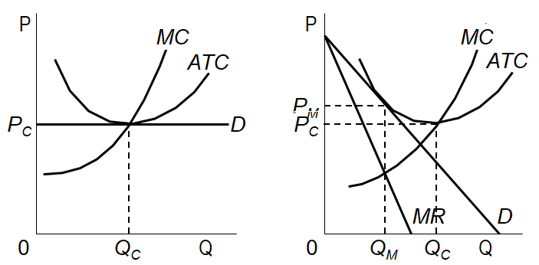
Comparing Monopolistic Competition and Perfect Competition long run
1511HS211 Economics
Perfect Competition
Monopolistic Competition
10

Slide 11
1511HS211 Economics
Practice Problems
In Mumbai city the movie market is monopolistically competitive. In long run, the demand for movies at the Regal theatre is given by the equation- P= 5- 0.002Q
Where Q is the number of paid admissions per month. The average cost is given by-
AC = 6 – 0.004Q+ 0.000001Q²
(a)To maximize profit, what price should the managers of regal charge?
(b) What will be the number of paid admissions per month?
(c) How much economic profit will the firm earn?

Slide 12
1511HS211 Economics
Amtex, a small manufacturing firm, is considering building a plant capable of producing 25 lakh wood pencils per year. Economies of scale are the only important barrier to entry in the industry. It is estimated that the average cost function is given by
AC = 100000 – 1000Q + 10.0 Q²
where Q is measured in lakhs of pencils per year. The current wholesale price of pencils is Rs 75000 per lakh and this price will not be affected by the entry of Amtex into the industry.
What is the minimum output rate necessary to allow a firm to earn at least a normal profit?
Will Amtex be able to earn normal profit?

Slide 13
1511HS211 Economics
MCQ(s)
1. In monopolistic competition market:
The products of different firms are unique without any close substitutes
The products of different firms are identical
The products of different firms are either identical or differentiated
The products of different firms are similar but slightly different
2. A firm in monopolistic competition market can influence its price and ________ influence the market average price.
only in the short run can
cannot
can
None of the above
3. Identify which of the following is NOT a feature of monopolistic competition?
Many sellers
Product differentiation
Many buyers
Homogenous products

Slide 14
1511HS211 Economics
MCQ(s)
4. In monopolistic competition market if a seller can convince buyers that its product is superior and is of more value as compared to other competitors in the market then
the demand of product increases
the seller gains more control over its price.
demand becomes more inelastic.
all of the above
5. In monopolistic competition market the demand curve of a firm is
perfectly inelastic as there are many substitutes for the firm's product.
less elastic than the demand curve facing a perfectly competitive firm.
horizontal, showing that MR = P.
perfectly elastic in the long-run, driving economic profits to zero.

Slide 15
References
1511HS211 Economics
H. C. Petersen, W. C. Lewis and S. K. Jain, Managerial Economics, 4th ed., Pearson Education 2006.
D. Salvatore, Managerial Economics in a Global Economy, 8th ed., Thomson Asia, 2015.
T.J. Webster, Managerial Economics: Theory and Practice, Emerald Group Publishing Limited, 2003
McTaggart, Findlay, Parking, Microeconomics, Pearson Education Australia, 2007

